Slide 1

Youth Participation in Electoral Processes
Dr. Robert Surujbally
Chairman
Guyana Elections Comission

Slide 2
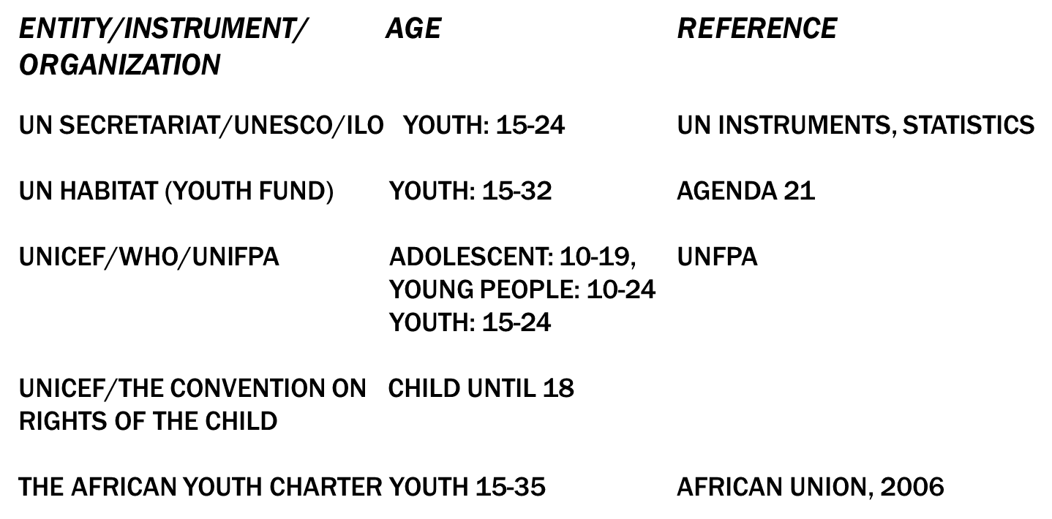

Slide 3
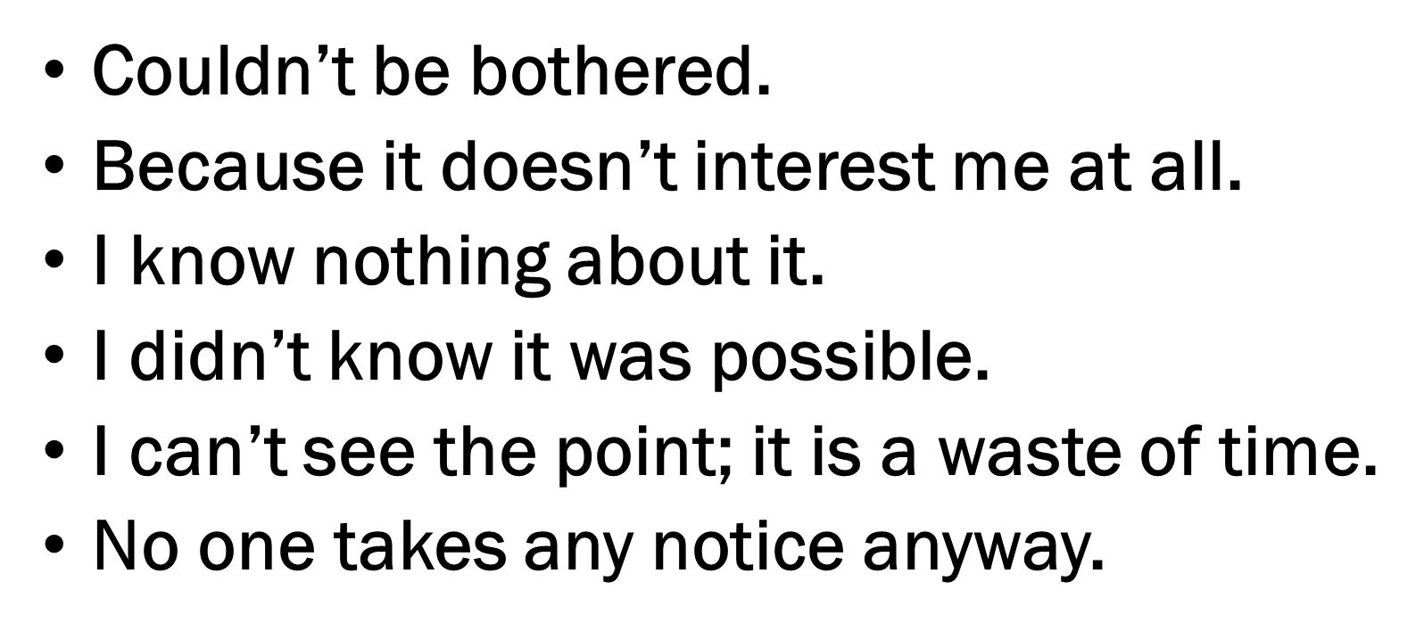
TYPICAL ANSWERS (1)

Slide 4
TYPICAL ANSWERS (2)
“Because the government doesn’t affect my day to day life. Therefor I don’t care who gets elected.”
“Because if it isn’t required by me, then I wouldn’t bother finding out about it. I would leave it to those who know and are passionate about it.”
“Why would you do anything you don’t like if you didn’t have to?”
“I don’t really care about politics, and am very disillusioned by the government.”
“Because either way they don’t care about the youth or young people, which is me and many other important issues. They will do what they want. Their promises mean nothing. So what’s the point?”
“I don’t think any of the parties have society’s thoughts at heart.......”

Slide 5
About one-in-two students feel they lack the knowledge to understand the issues, the political parties, to make a decision about voting, and in general to vote.
Young people do not perceive themselves generally as well prepared to participate in voting
Generally, young people don’t understand the voting system.

Slide 6
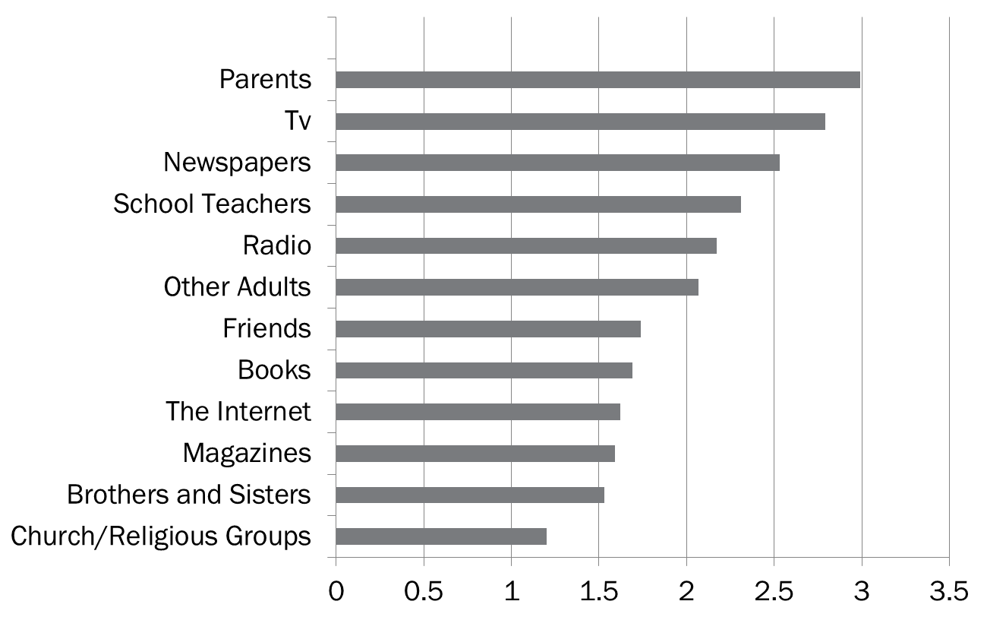
Source of Information about Voting in Elections

Slide 7
How Exciting Are the Following Events?

Slide 8
Slide # 7 Main Reasons for Not Voting in 2000 (open-ended; multiple responses; % of respondents)
 | Age in 2000
 | 55+ | 45-54 | 35-44 | 25-34 | 18-24 | Total
Lack of interest | 32 | 30 | 34 | 41 | 39 | 37
Not interested: didn’t care; apathy | 23 | 18 | 20 | 27 | 28 | 25
Vote meaningless: won’t count; election forgone conclusion | 8 | 10 | 10 | 11 | 7 | 9
Forgot: unaware | 2 | 0 | 1 | 2 | 4 | 2
Too complicated; confusing | 0 | 2 | 3 | 1 | 0 | 1
Negativity | 30 | 50 | 46 | 32 | 27 | 34
No appealing candidates/parties issues | 12 | 23 | 21 | 14 | 14 | 16
Lack of faith/confidence in candidates/parties/leaders | 15 | 21 | 17 | 14 | 6 | 13
Lack of information about candidates/parties/issues | 1 | 3 | 5 | 3 | 6 | 4
Regional discontent | 2 | 3 | 3 | 1 | 1 | 1
Personal/Administrative | 46 | 33 | 28 | 35 | 43 | 37
Too busy with work/school/family | 4 | 3 | 12 | 14 | 23 | 14
Away from riding/province/country | 22 | 9 | 8 | 11 | 8 | 10
Registration problems | 3 | 7 | 3 | 5 | 7 | 6
Illness, health issues | 12 | 8 | 2 | 2 | * | 3
Didn’t know where or when; polling station problems; transportation | 5 | 3 | 3 | 2 | 4 | 3
Moving-related problems | 0 | 3 | 1 | 1 | 1 | 1
Other | 5 | 3 | 5 | 3 | 5 | 4
Religious reasons | 4 | 2 | 2 | 1 | 1 | 2
Other; unclassifiable; unclear; none | 1 | 1 | 3 | 2 | 4 | 2
N= | 101 | 109 | 171 | 331 | 347 | 1.059
* Less than 1 percent

Slide 9
Slide # 8 Perceived Reasons Why Young People Are Less Likely to Vote (open-ended; multiple responses; % of respondents)
 | Under 25 Years old | 25 and older
Not integrated | 79 | 71
Distanced from politics by age; not feeling represented, connected | 40 | 37
Lack of information, understanding, knowledge | 34 | 27
Lack of encouragement | 2 | 4
Too busy, too mobile | 3 | 3
Disengagement | 51 | 59
Uninterested, apathetic | 31 | 30
Negativism, cynicism, disillusionment | 9 | 14
Distrustful of system, politicians | 7 | 9
Irresponsibility, rebelliousness, laziness | 4 | 6
Other | 2 | 4
Do not know | 0 | *
N= | 386 | 1420
* Less than 1 percent

Slide 10

MOST INMATES 18-25 YEARS OLD

Slide 11
POSSIBLE SOLUTIONS
Education! Education! Education!
EMBs involvement with schools even prior to eligible age for voting
Pre-Registration Exercises; registration right up to close of Poll
Introducing “Civics” into the School Curriculum
Advertising – using all available space (e.g. busses, prominent places, “hang-out” spots, etc
Use of popular entertainers/concerts to spread the message
Incentives to registration/Voting
Commemorative Certificates for first time voters
Recruiting/Hiring young people as clerks during the pre-, peri- and post-Election Day period
Establish special Voter Registration Projects
Engaging “Social Media”
Partnering with the creative industries like ................., music, theatre,
Using mobile caravans, with actors carrying the message
TV Skits and Radio Programmes
Easily accessible Registration Offices and Polling Stations
Mobile Registration Centres
Use of tents in far-flung areas
TV debates and Panel Discussions

